Slide 1

SoEN 6441 Advanced Programming Practices Project -Winter 2024
Build 3:
Submitted by: Team 09
Jayasurya Pazhani [40289512]
Jayanth Apagundi [40291184]
Shuvanidhi Suresh [40293590]
Shahul Hameed [40290787]
Vinisha Kora Venkatesalu [40293927]
Submitted to:
Professor Joey Paquet

Slide 2
AGENDA
Architecture Diagram
Adapter Pattern
Adapter Pattern Usage
Strategy Pattern

Slide 3
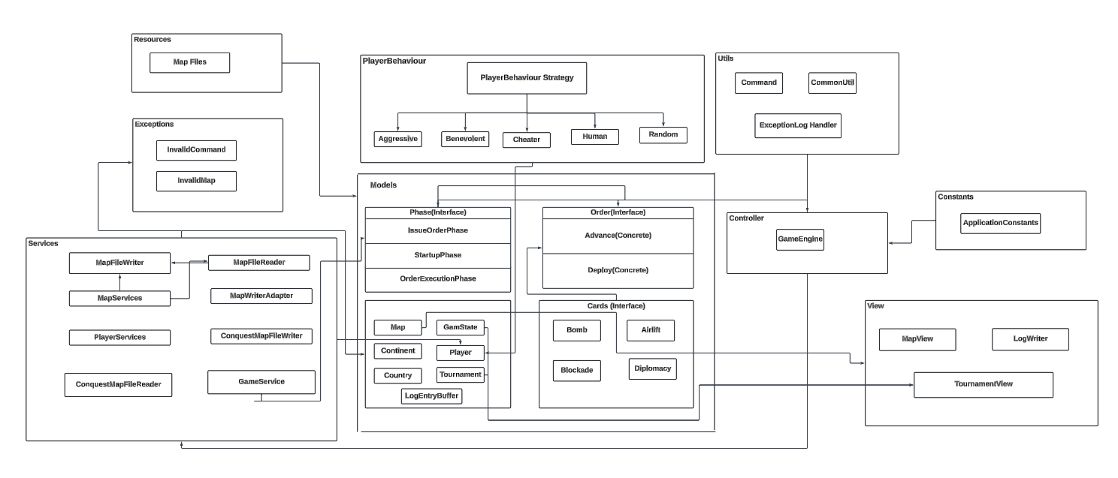
ARCHITECTURE DIAGRAM

Slide 4
ADAPTER Pattern
The Adapter Pattern is a structural design pattern that allows objects with incompatible interfaces to work together. In our code, the Adapter Pattern is utilized to adapt the interface of ConquestMapFileReader and ConquestMapFileWriter to match the MapFileReader and MapFileWriter interfaces respectively.
Following slides describe how the Adapter Pattern has been used in the code.

Slide 5
ADAPTER Pattern USAGE
MapReaderAdapter Class:
Role: Adapter for ConquestMapFileReader.
Inheritance: MapReaderAdapter extends MapFileReader. This means it can be used wherever a MapFileReader is expected.
Composition: The MapReaderAdapter class has a private member variable l_conquestMapFileReader of type ConquestMapFileReader.
Delegation: The parseMapFile method in MapReaderAdapter doesn't implement the parsing logic itself. Instead, it delegates the parsing task to the readConquestFile method of l_conquestMapFileReader. This way, the MapReaderAdapter acts as a bridge between MapFileReader and ConquestMapFileReader, making ConquestMapFileReader compatible with the MapFileReader interface.

Slide 6
ADAPTER Pattern USAGE
MapWriterAdapter Class:
Role: Adapter for ConquestMapFileWriter.
Inheritance: MapWriterAdapter extends MapFileWriter, allowing it to be used wherever a MapFileWriter is expected.
Composition: Similar to MapReaderAdapter, MapWriterAdapter has a private member variable l_conquestMapFileWriter of type ConquestMapFileWriter.
Delegation: The parseMapToFile method in MapWriterAdapter delegates the task of parsing the map file to the parseMapToFile method of l_conquestMapFileWriter. This allows ConquestMapFileWriter to be used in a context where MapFileWriter is required.

Slide 7
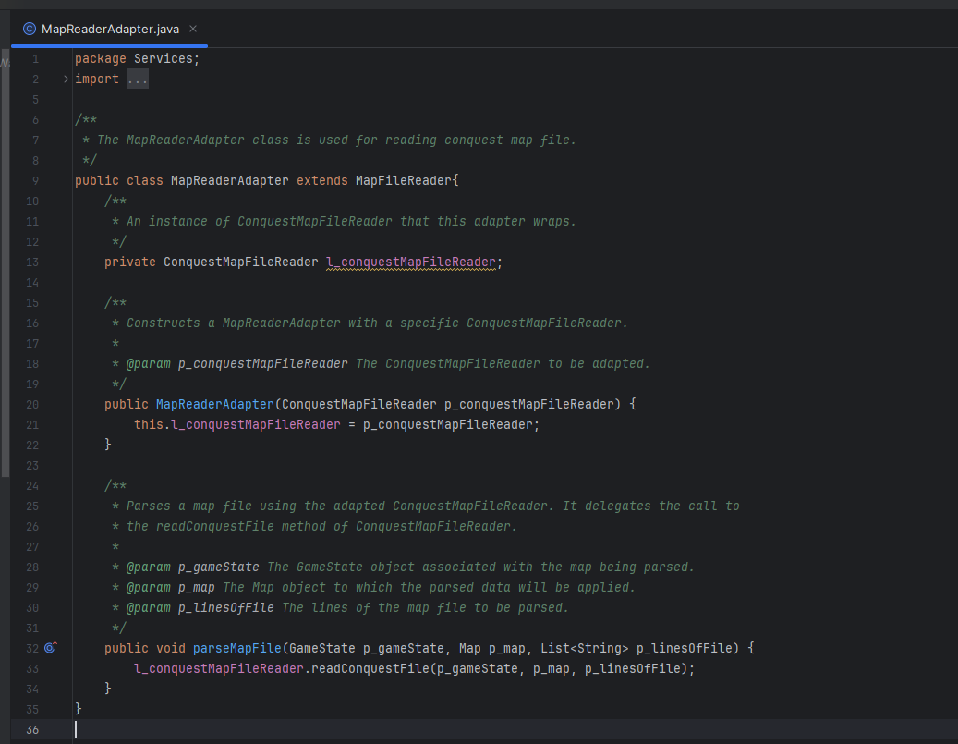
Adapter Pattern:

Slide 8
STRATEGY Pattern
Strategy Pattern in Player Class:
Strategy Interface: Introduced PlayerBehaviorStrategy as the strategy interface for player behaviors.
Strategy Attribute: Added d_playerBehaviorStrategy in Player class to hold an instance of the behavior strategy.
Setting Strategy: Implemented setStrategy() method to dynamically assign a strategy to the player.
Using Strategy: Utilized strategy in getPlayerOrder() to delegate order creation and in other methods like checkForMoreOrders() and createDeployOrder() for behavior-based decision-making.

Slide 9
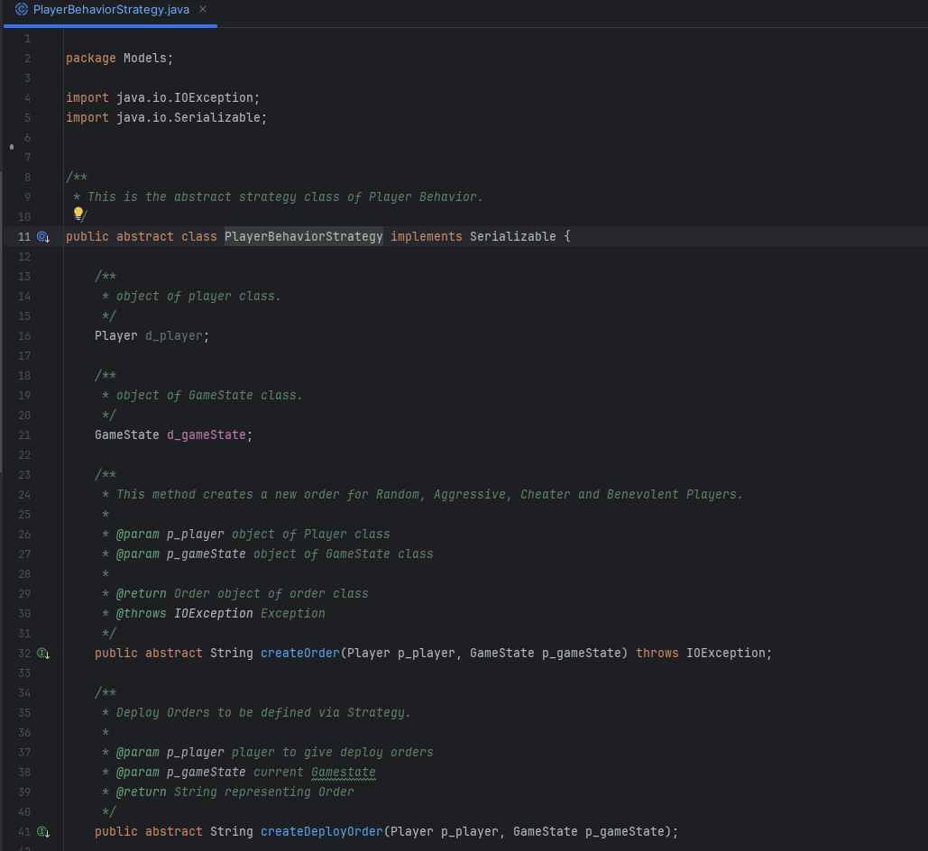
Strategy Pattern:

Slide 10
THANK YOU

